Slide 1

ASTRA TEAM
Shanti Siburian
Diva Hizbullah
Bangkit Finaldi
Bayu Nur priambodo

Slide 2
Use Case Diagram

Slide 3
Business Process

Slide 4
Class Diagram

Slide 5
Data Model

Slide 6
DATA FLOW DIAGRAM

Slide 12
SEQUENCE DIAGRAM

Slide 16
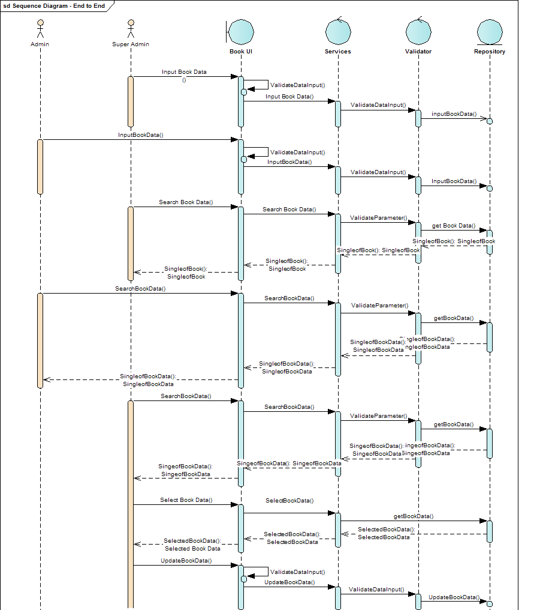

Slide 17
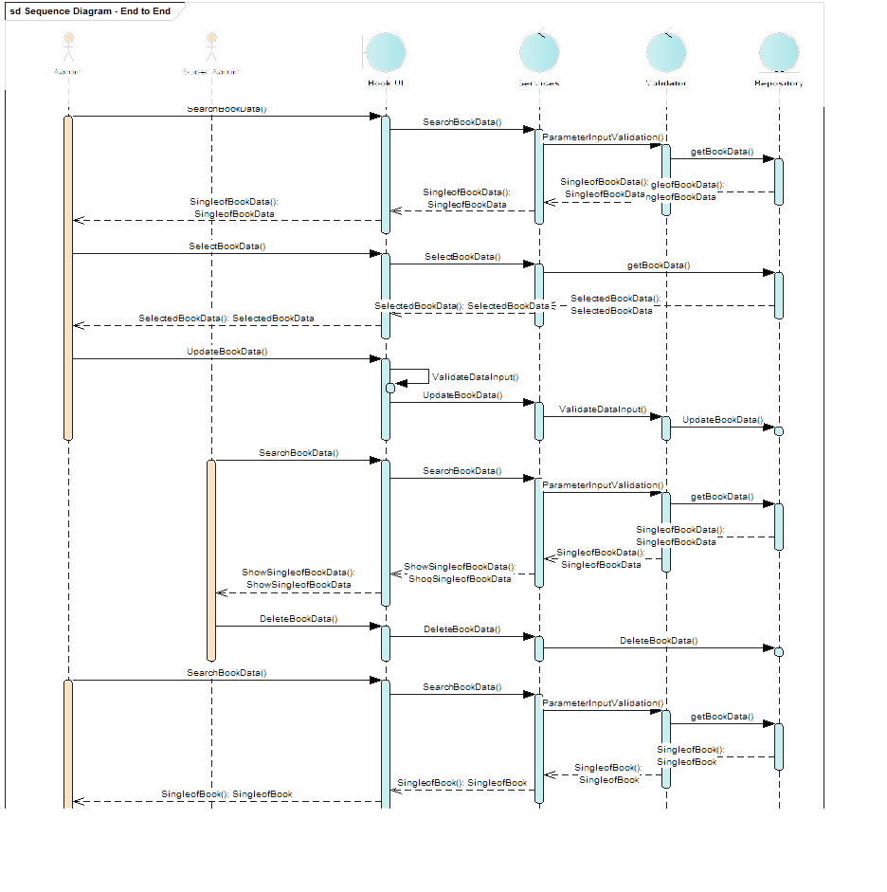

Slide 18
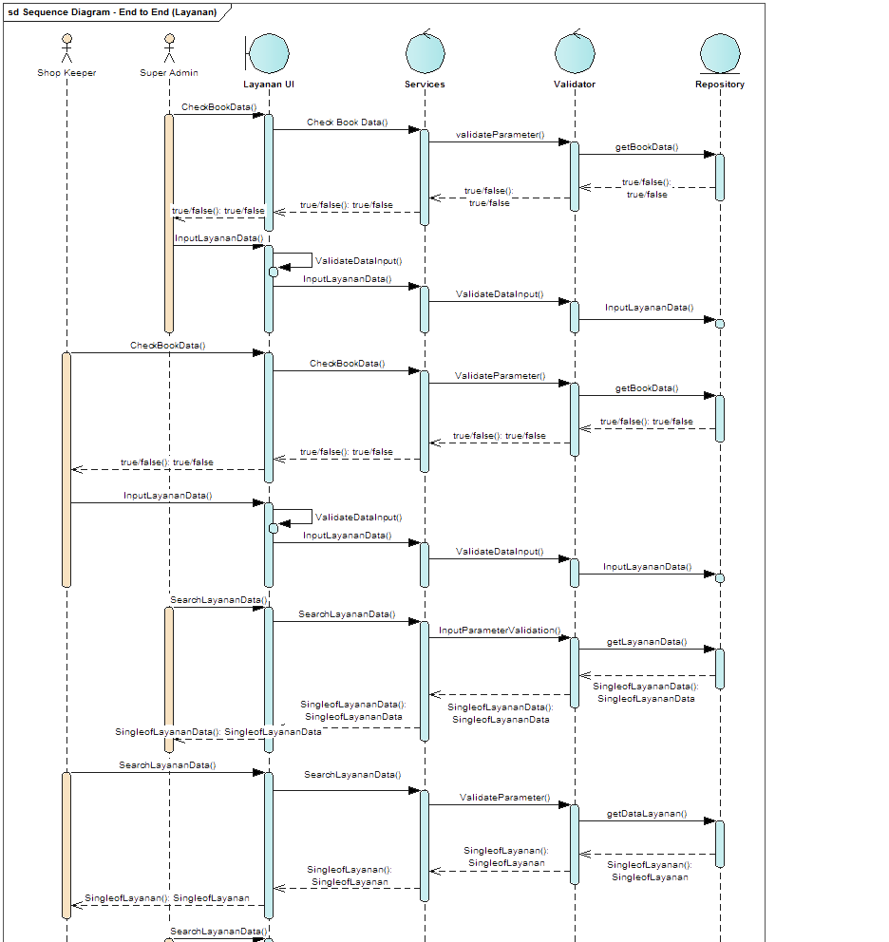

Slide 19
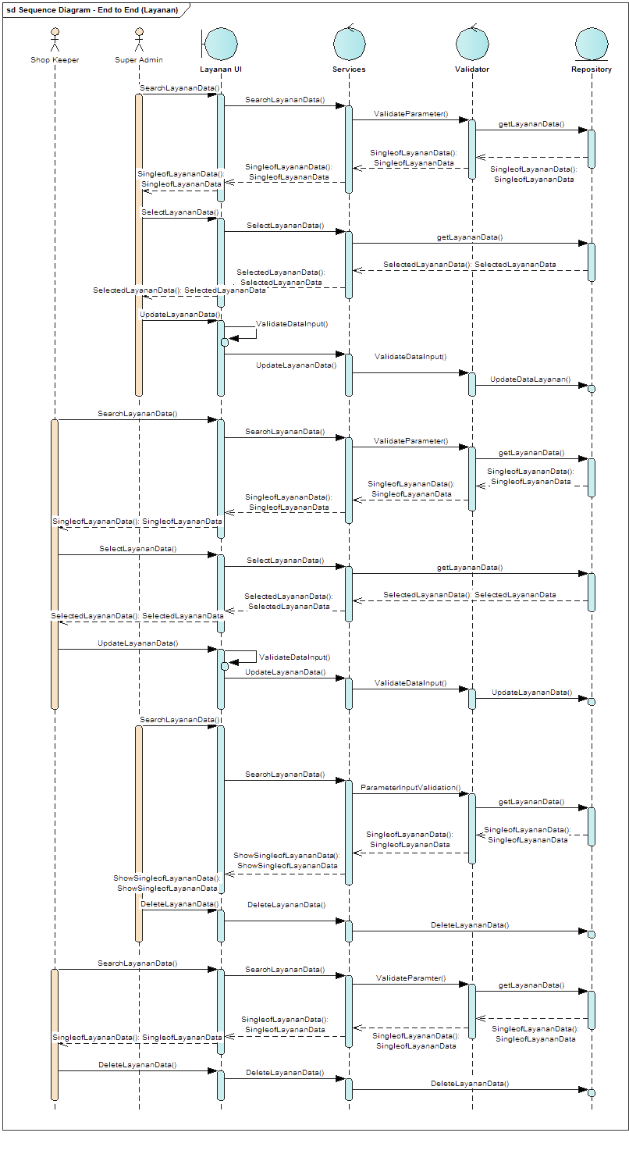

Slide 20
User InterFace (layout)

